Slide 1


Video Game Recommendations
Hao He, Justin Wagers, Manan Desai

Slide 2
Research Question
Based on a user’s gaming history, can we recommend a game that they will enjoy?
Based on how much time a player has spent playing previous games and their similarity to other video game players, we would like to create a recommendation system for video games.
In other words, we want to predict which games a user is likely to spend the most time playing. This prediction would allow for user-specific video game advertising.

Slide 3
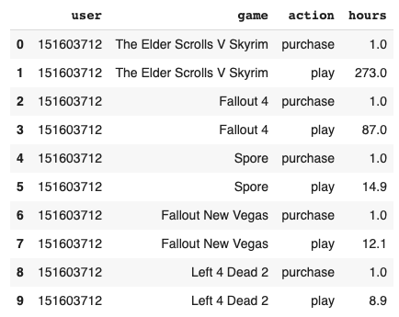
Data Description
Describes hours played per game on the Steam platform
5,155 unique games
12,393 unique users

Slide 4
Methodology
MDS and K-means to cluster/segment users and games into groups
Heuristics to segment customers using hours played as a metric for ratings
User-based collaborative filtering
Game-based collaborative filtering
Matrix Factorization to solve problems created by collaborative filtering

Slide 5
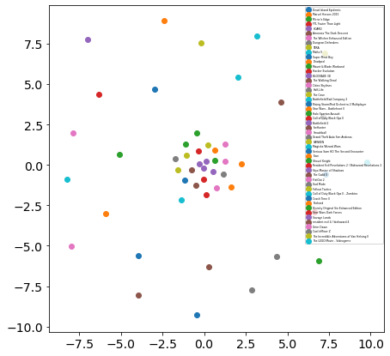
Exploratory Analysis
Visualizing Game Similarity
Games in the center cluster:
Call of Duty Black Ops II - Zombies
Star Wars - Battlefront II
Counter-Strike Global Offensive
Games outside of the center cluster:
Dota 2 (top of the popularity list on Steam)
Portal 2
The LEGO Movie - Videogame

Slide 6
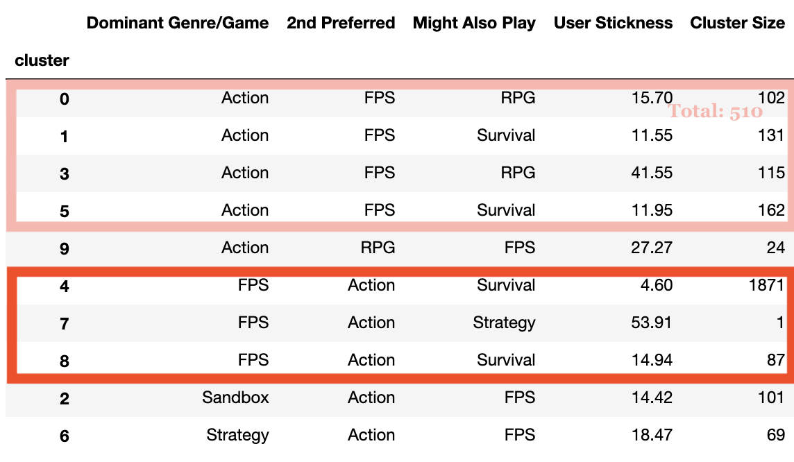
User-Based Market Segmentation

Slide 7
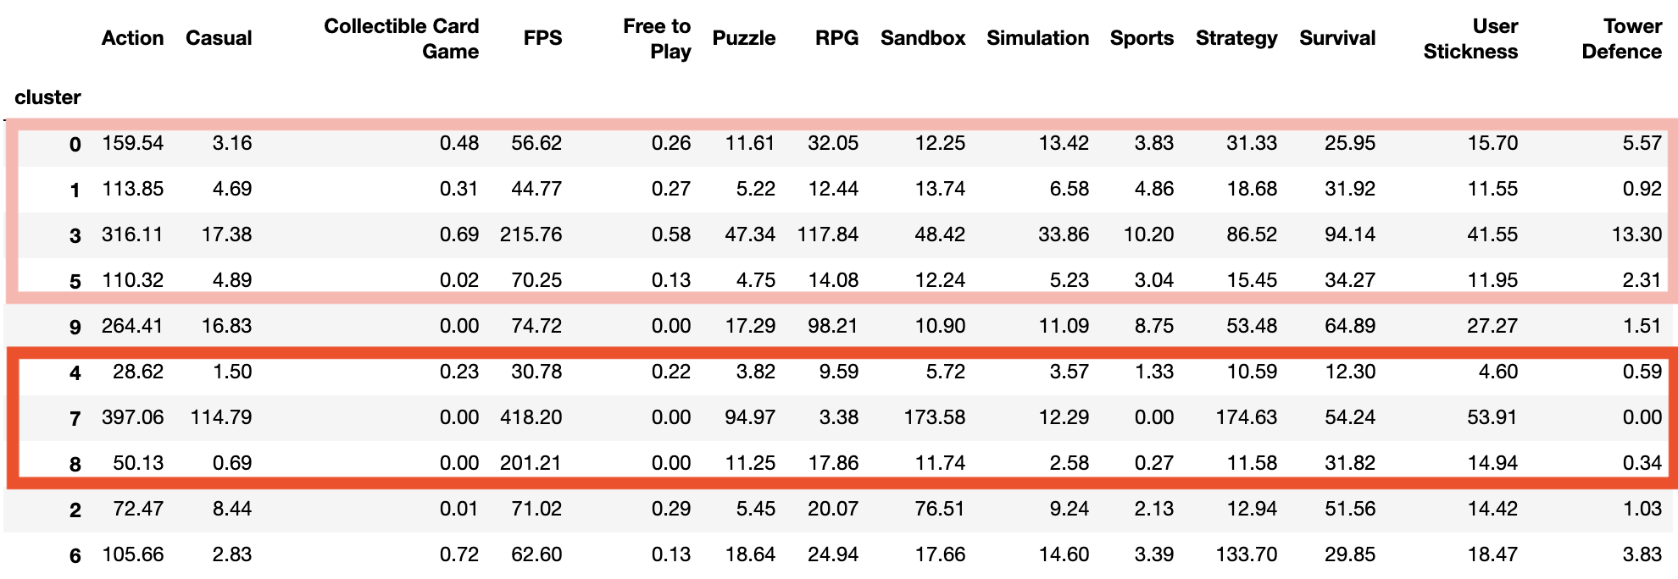
User-Based Market Segmentation

Slide 8
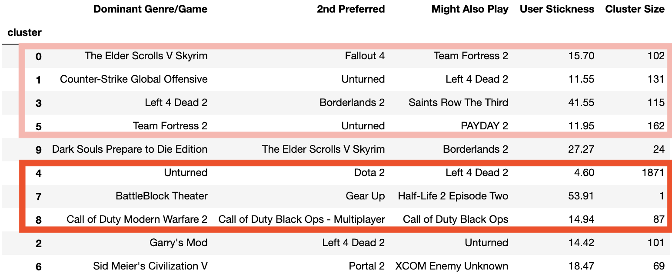
User-Based Market Segmentation

Slide 9
Recommendation Engines

Slide 10
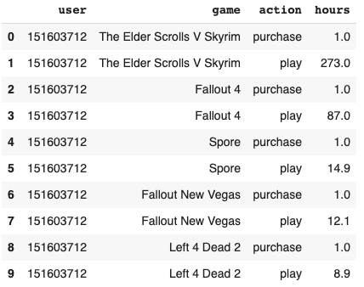
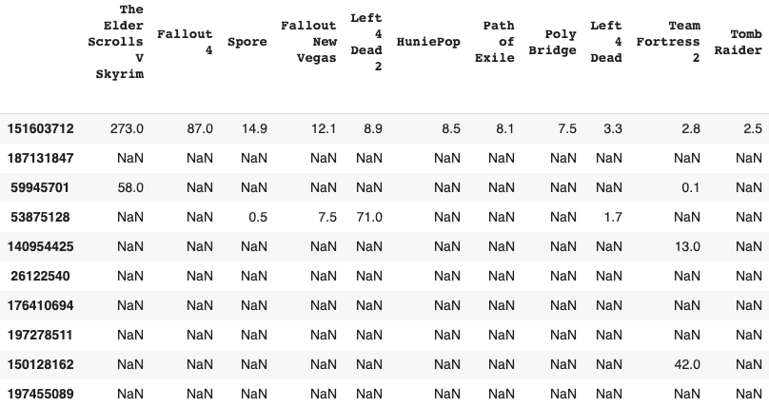
Data Preprocessing

Slide 11
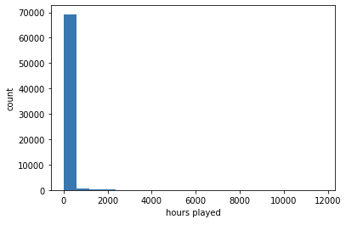
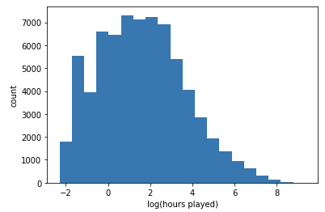
Data Pre-Processing

Slide 12
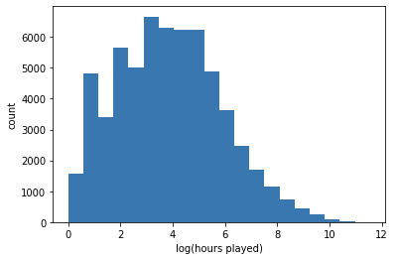
Data Preprocessing
Roughly analogous to a 0 to 10 rating scale

Slide 13

Collaborative Filtering Overview

Slide 14
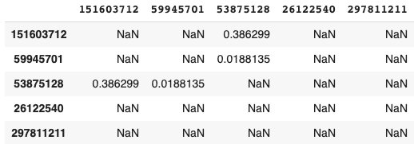
User-Based Collaborative Filtering
Construct user correlation matrix
Users must have rated some games
For two users to have a correlation coefficient, they must have at least n games in common, where n > 2
Very long runtime
…
…

Slide 15
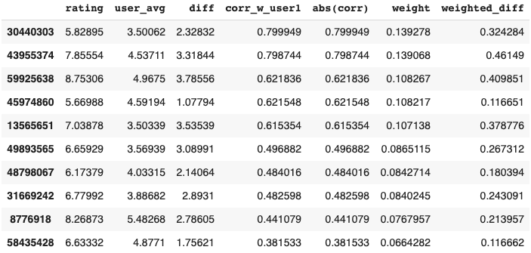
User-Based Collaborative Filtering
Given a user U:
find U’s average rating U_{avg}
for game in games not played
get users who have played it
get subset of those users who have a similarity rating w/ U
get top n users by magnitude of correlation
calculate sum of weighted difference 𝝨w
add 𝝨w to U_{avg} = predicted rating
recommend game with highest predicted rating

Slide 16
Example matrix
Note: coincidence that all correlations are positive, though correlation matrix contains mostly positives

Slide 17

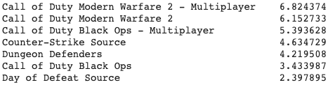
Example Recommendation
Predicted rating: 7.435

Slide 18
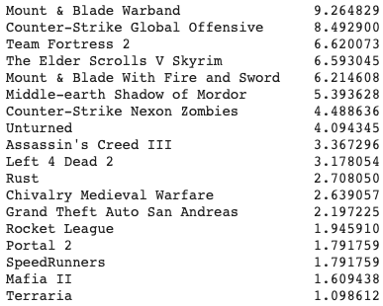

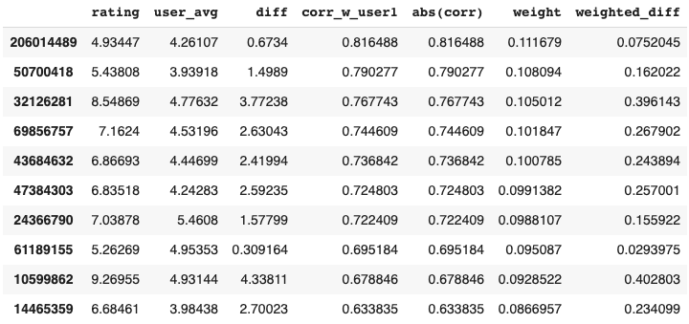
Example Recommendation 2
Predicted rating: 6.31

Slide 19
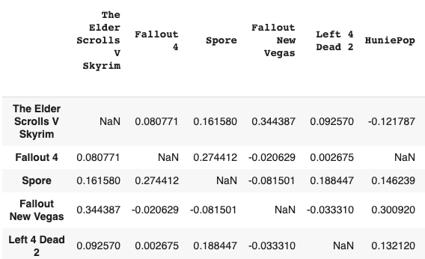
Item-Based Collaborative Filtering
Similar algorithm to user-based but from different perspective
Construct item-by-item correlation matrix
Still many pairs with no correlation (when # users who play both games < n)
…
…

Slide 20

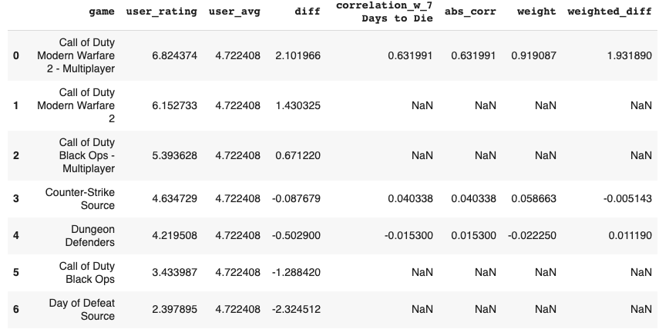
Example Recommendation
Predicted rating: 6.66

Slide 21

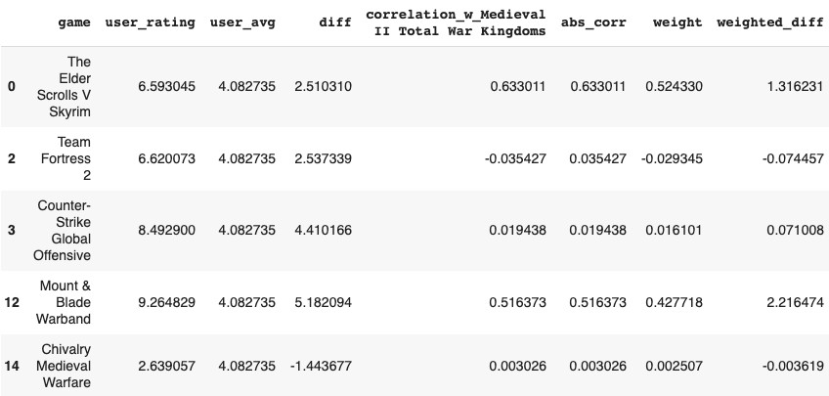
Example Recommendation 2
Predicted rating: 7.61
Note: in bottom right image, 13 games with NA weight were removed

Slide 22

User-Based vs Item-Based Filtering
To our eye test, user-based seemed better
In reality, would probably use some type of market test

Slide 23
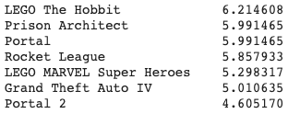
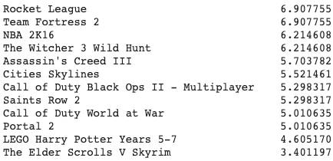
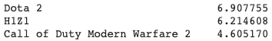



Our Recommendations
Justin
Manan
Hao

Slide 24
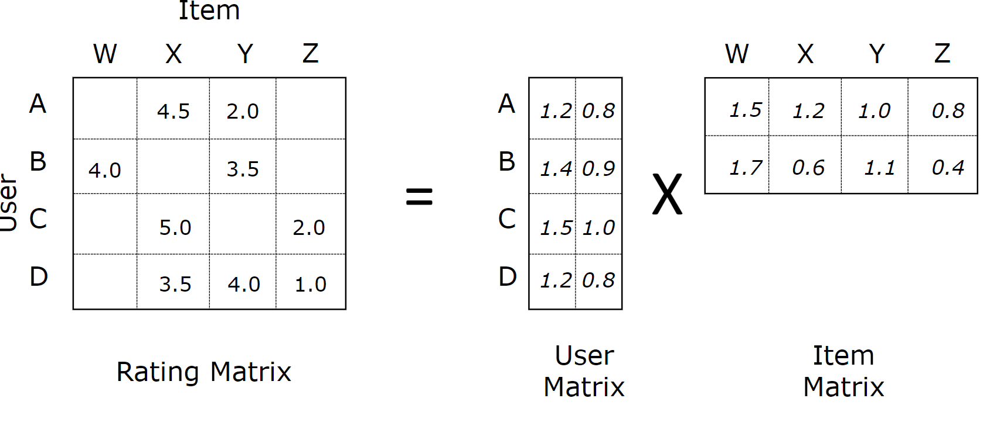
Collaborative Filtering Shortcomings
Time not a factor
Not fixable by basic CF
Cold start problem
We set thresholds in our algorithm that Hao did not pass
We could lower thresholds → possibly worse predictions
Matrix sparsity
Solution to latter 2 is matrix factorization

Slide 25
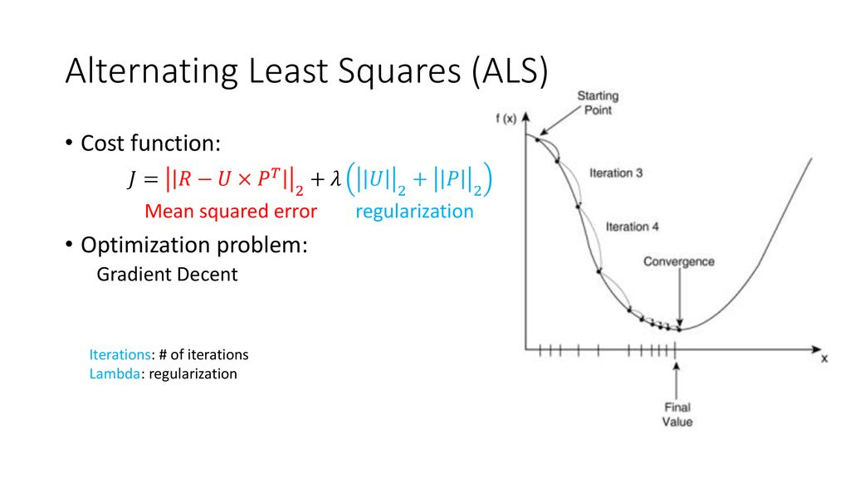
Matrix Factorization

Slide 26
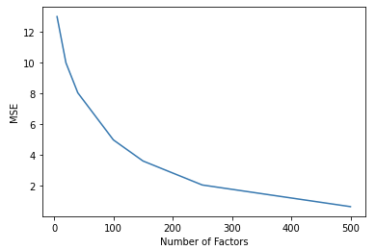
How many latent attributes?
Obviously, error will decrease the more attributes
Bias-Variance tradeoff, overfitting
We chose 250
Regularization parameter?

Slide 27
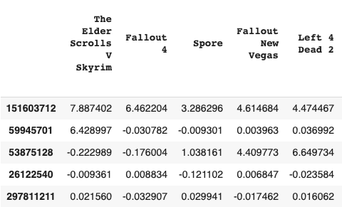
Matrix Factorization
Leads to dense matrix
Makes recommendations easy
Much faster
…
…

Slide 28
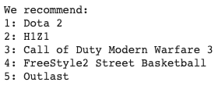
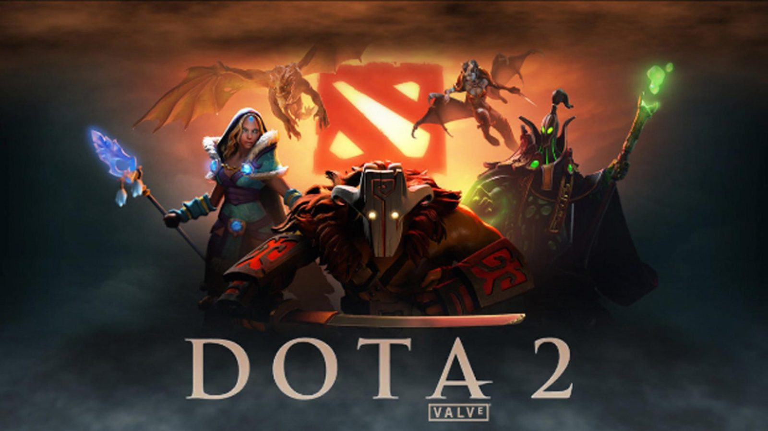
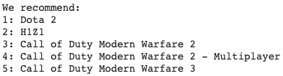
Recommendations
Test User 2
Test User 1

Slide 29

Our Recommendations
Justin
Manan
Hao

Slide 30


Matrix Factorization Overview
Much faster
Could recommend for newer users
Clearly skewed towards popularity
Possible alteration of ALS parameters could change that
Might work better using actual ratings

Slide 31
Conclusion
Hours played can be an effective metric (not just ratings)
MDS and K-means can be somewhat effective tools to cluster
Collaborative Filtering can be successful, but many drawbacks
Sparsity
Cold-Start
Time
Matrix Factorization can solve some of these problems but introduce others
Large skew towards popularity
Many more parameters to consider

Slide 32
The perfect recommendation system doesn’t exist.
(but companies won’t stop trying)

Slide 33
Appendix

Slide 34
Some of our code
(a little messy and undocumented)
Collaborative Filtering and Matrix Factorization: https://colab.research.google.com/drive/1wCSAZkgYryNDh3tC9fBDNusvMFvhlQeV
MDS:
https://colab.research.google.com/drive/1uSkSXk1yohFqaBFYc_FwojRAHoOA3ehV?usp=sharing
User-based Market Segmentation:
https://github.com/haohe1113/Steam-Game-Rcmd-Engine/blob/master/steam_market_segmentation.ipynb

